Slide 1

Social Media Application
Task - 5

Slide 2


Social Media Application
A social media platform is a digital hub for connecting, sharing, and interacting.
Users create profiles and post user-generated content, including text, images, videos, and links, which others engage with through likes, comments, and shares.
These platforms foster global connections and impact personal relationships, politics, business, and society at large.
▪
LMS Username | Name | Batch
au910020104039 | Sankari B R P | CC_2
au910020104046 | Uvasri S A | CC_2
au910020104307 | Neelakandan T | CC_2

Slide 3
Task 5
Technical Specifications:
HTML
CSS
React Js , Express Js
MySQL
AWS / Azure
Description:
Choose a reliable hosting provider like AWS, Azure, or others based on the application's requirements.
Set up a virtual server with an appropriate hosting plan and select an operating system.
Install and configure a web server to handle HTTP requests, and set up a database server for storing application data.
Register a domain name and configure DNS settings to point to your server.
Enhance security with firewalls and intrusion detection.

Slide 4
Consider additional strategies like clustering or sharding to distribute the database load and support future growth in the user base.
Step-Wise Description :
Research and choose a hosting provider based on factors such as performance, scalability, pricing, and available services.
Sign up for a hosting plan and deploy a virtual server (VPS) with the chosen hosting provider.
Choose an operating system and configure it on the virtual server.
Install and configure a web server on the virtual server to handle incoming HTTP requests.
Set up a database server to store and manage the application's data.
Register a domain name through a domain registrar and configure DNS settings to point to the IP address of your virtual server.
Implement SSL/TLS certificates using services like Let's Encrypt to enable secure communication over HTTPS.
Enhance security by configuring firewalls, intrusion detection systems, and regularly updating the server's operating system and installed software.
Set up monitoring tools to track server performance, detect potential issues, and gather analytics on user interactions.
, and

Slide 5
Consider additional strategies like clustering or sharding to distribute the database load and support future growth in the user base.
Task Summary :
To host the social media application website created with HTML, CSS, React.js, and MySQL, the first step involves selecting a hosting provider such as AWS or Azure and deploying a virtual server with an operating system like Ubuntu. Following this, web and database servers, like Nginx or Apache and MySQL, respectively, need to be set up to handle HTTP requests and store application data. The React.js front-end is then deployed on the server, ensuring seamless interaction with the MySQL database through API calls. Domain registration and DNS configuration are performed to establish the application's online presence, complemented by SSL/TLS certificates for secure data transmission. Security measures, including firewalls and regular updates, are implemented, and monitoring tools are set up to track server performance. Robust backup and recovery strategies are established, and thorough testing is conducted to validate the application's functionality in the production environment. Finally, comprehensive documentation is maintained, covering hosting setups, configurations, deployment processes, and other essential details for future reference and maintenance.trends

Slide 6
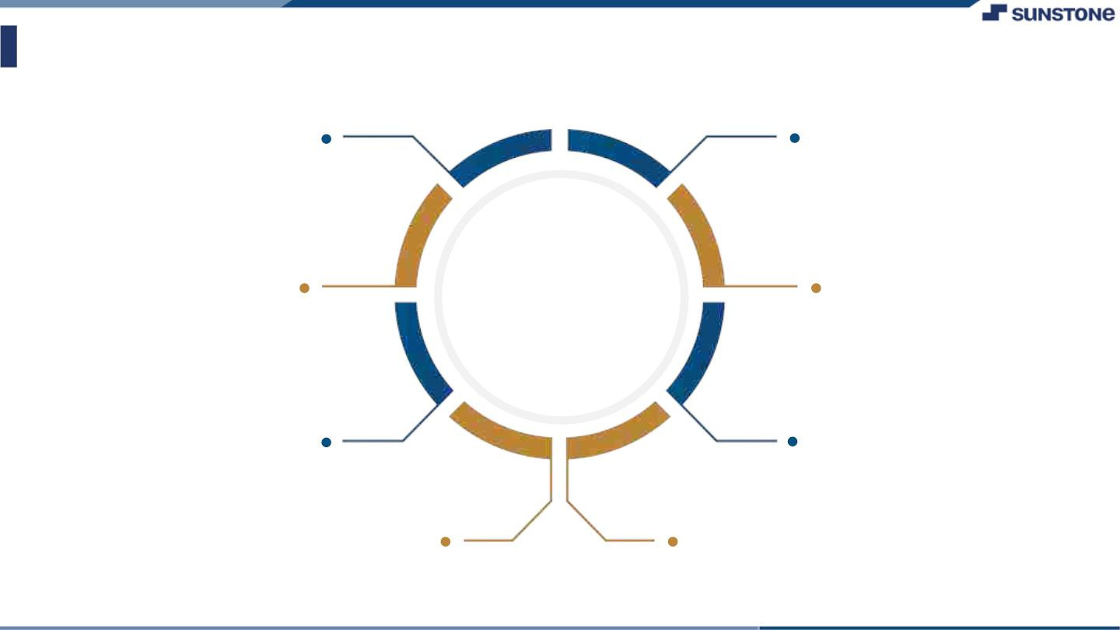
Assessment Parameter
Choose a reliable hosting provider and deploy a virtual server with an appropriate operating system
Conduct thorough testing to ensure the application functions correctly in the production environment.
Install and configure a web server to handle HTTP requests and a MySQL database to store application data.
Check-List
Establish a robust backup strategy for both the application code and the MySQL database.
Deploy the React.js front-end of the social media application on the server.
Set up monitoring tools to track server performance and detect potential issues.
Register a domain name for the application and configure DNS settings to point to the server's IP address.
Implement security measures such as firewalls and regular updates to protect the server and application.

Slide 7
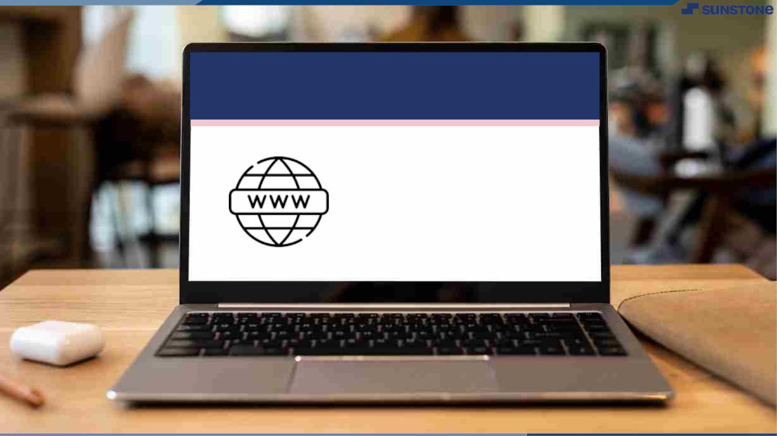
Submission Github
https://github.com/Uvasrisa/Social_media_application

Slide 8


